Slide 1
JAVA COMMENTS

Slide 2
JAVA COMMENTS:
The Java comments are the statements in a program that are not executed by the compiler and interpreter.

Slide 3
COMMENTS
Why do we use comments in a code?
Comments are used to make the program more readable by adding the details of the code.
It makes easy to maintain the code and to find the errors easily.

Slide 4
COMMENTS
The comments can be used to provide information or explanation about the variable, method, class, or any statement.
It can also be used to prevent the execution of program code while testing the alternative code.

Slide 5
Single line comments:
The single-line comment is used to comment only one line of the code. It is the widely used and easiest way of commenting the statements.
Single line comments starts with two forward slashes (//). Any text in front of // is not executed by Java.

Slide 6
CommentExample1.java
public class CommentExample1 {
public static void main(String[] args) {
int i=10; // i is a variable with value 10
System.out.println(i); //printing the variable i
}
}

Slide 7
JAVA MULTI LINE COMMENTS
The multi-line comment is used to comment multiple lines of code.
It can be used to explain a complex code snippet or to comment multiple lines of code at a time (as it will be difficult to use single-line comments there).
Multi-line comments are placed between /* and */. Any text between /* and */ is not executed by Java.

Slide 8
Syntax:
/*
This
is
multi line
comment
*/

Slide 9
CommentExample2.java
public class CommentExample2 {
public static void main(String[] args) {
/* Let's declare and
print variable in java. */
int i=10;
System.out.println(i);
/* float j = 5.9;
float k = 4.4;
System.out.println( j + k ); */
}
}

Slide 10
Output:
10

Slide 11
JAVA DOCUMENTATION COMMENT
Documentation comments are usually used to write large programs for a project or software application as it helps to create documentation API.
These APIs are needed for reference, i.e., which classes, methods, arguments, etc., are used in the code.
To create documentation API, we need to use the javadoc tool.
The documentation comments are placed between /** and */.

Slide 12
syntax
/**
*
*We can use various tags to depict the parameter
*or heading or author name
*We can also use HTML tags
*
*/

Slide 13
ARE JAVA COMMENTS EXECUTABLE
As we know, Java comments are not executed by the compiler or interpreter, however, before the lexical transformation of code in compiler, contents of the code are encoded into ASCII in order to make the processing easy.

Slide 14
ARE JAVA COMMENTS EXECUTABLE
public class Test{
public static void main(String[] args) {
//the below comment will be executed
// \u000d System.out.println("Java comment is executed!!");
}
}

Slide 15
Test.java
public class Test{
public static void main(String[] args) {
//the below comment will be executed
//
System.out.println("Java comment is executed!!");
}
}

Slide 16
What is Internship????
Learn
Practice
Verify
Get Certified
Grow

Slide 17
Pantech will make you to create 6 Projects in Java in 30 Days
Objective of this 30 Days Master Class

Slide 18
1 Month Internship in Java Full Stack
INTERNSHIP E-Certificate (30Days Internship on Java Full Stack)
Highly organized Video content
Download Project Files
Download PPTs
Assignments
Weekly Hackathons
Flexible Time.
Access Period: 60Days from the date of payment
Community or Forum Support

Slide 19
What You Will Get???
Project Files of Java
30 Days Learning Practice
Servlet concepts
+ Projects
Erasure Coding(Day 25)
Public Auditing(Day 26)
Counselling Management System(Day 27)
Software Puzzle(Day 28)
Crime Management System(Day 29)
Secure Multi-Owner Data Sharing(Day 30)
Project PPT
Video Class Access for 2 Months
Get chance to Enroll 1-Month Internship on demand

Slide 20
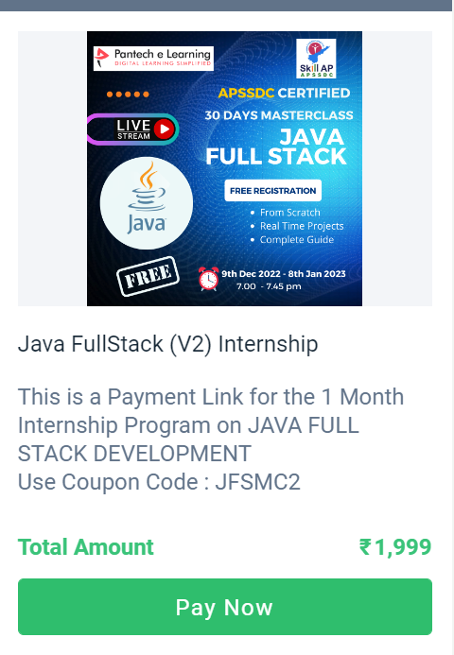
How to Enroll into 1 month Internship?
https://imjo.in/gHNkDr
REG FEE : Rs.1999 Rs.999
COUPON CODE : JFSMC2

